Slide 1
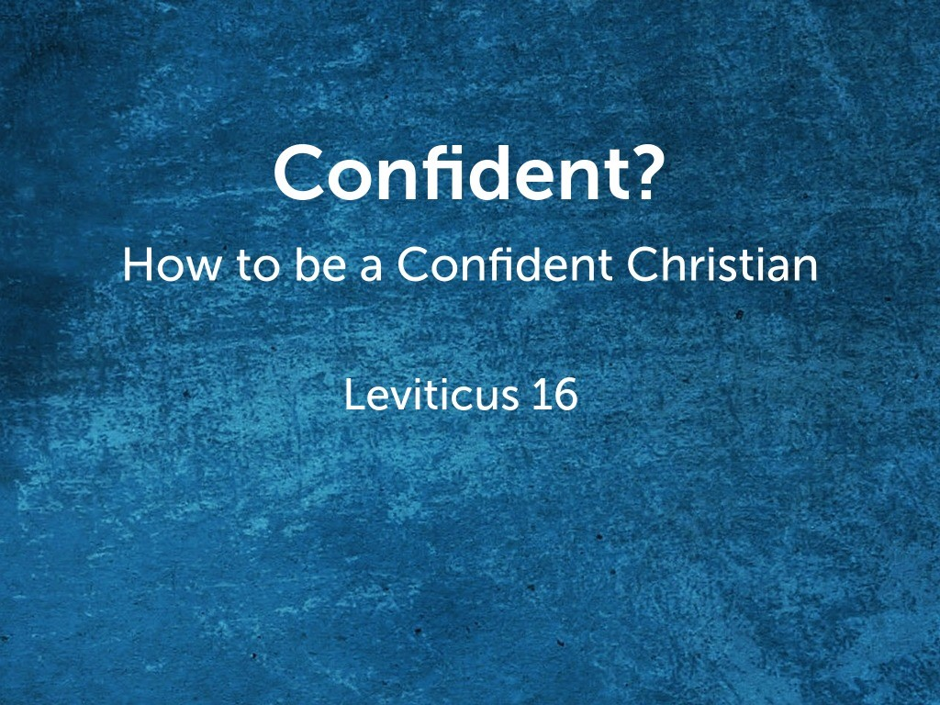

Slide 2
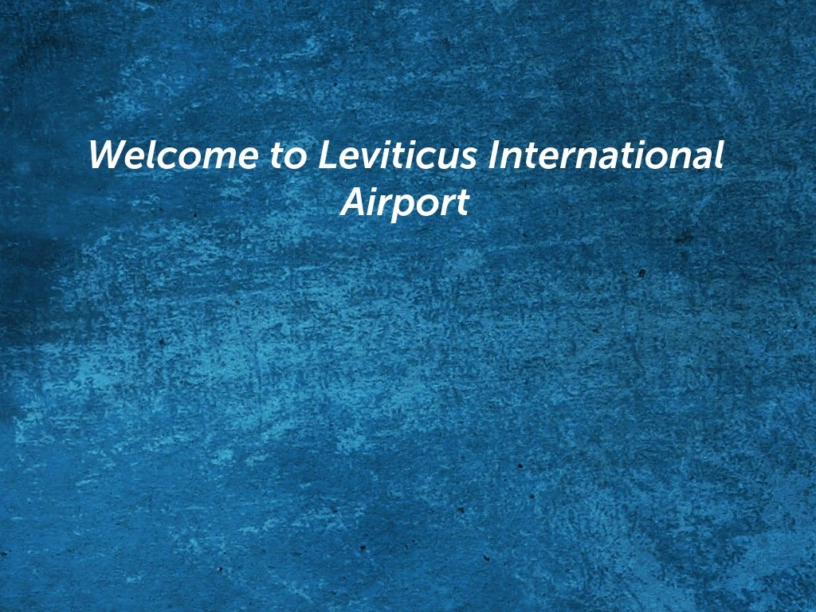
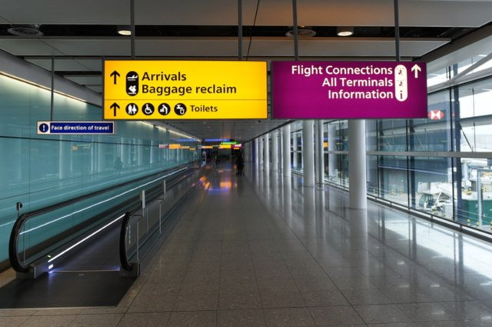

Slide 3
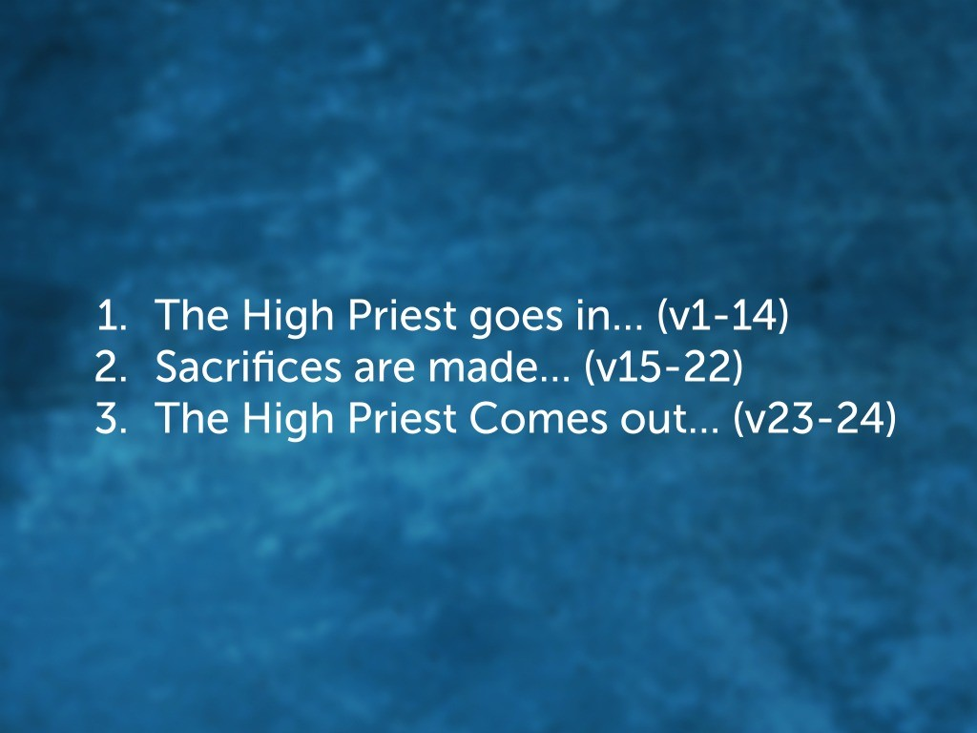

Slide 4
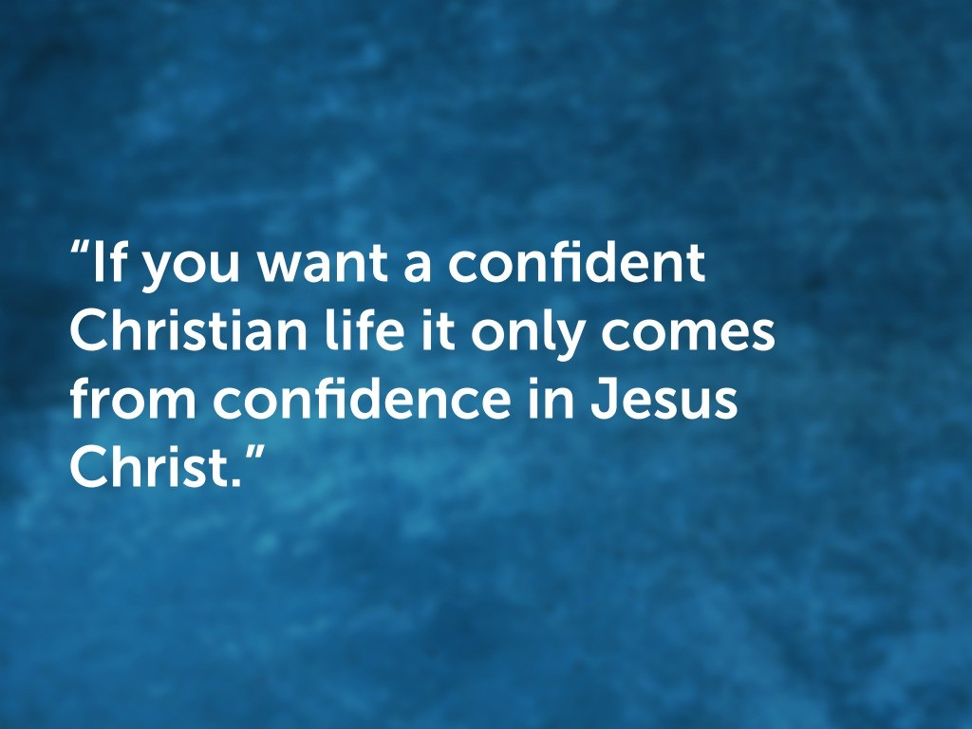

Slide 5
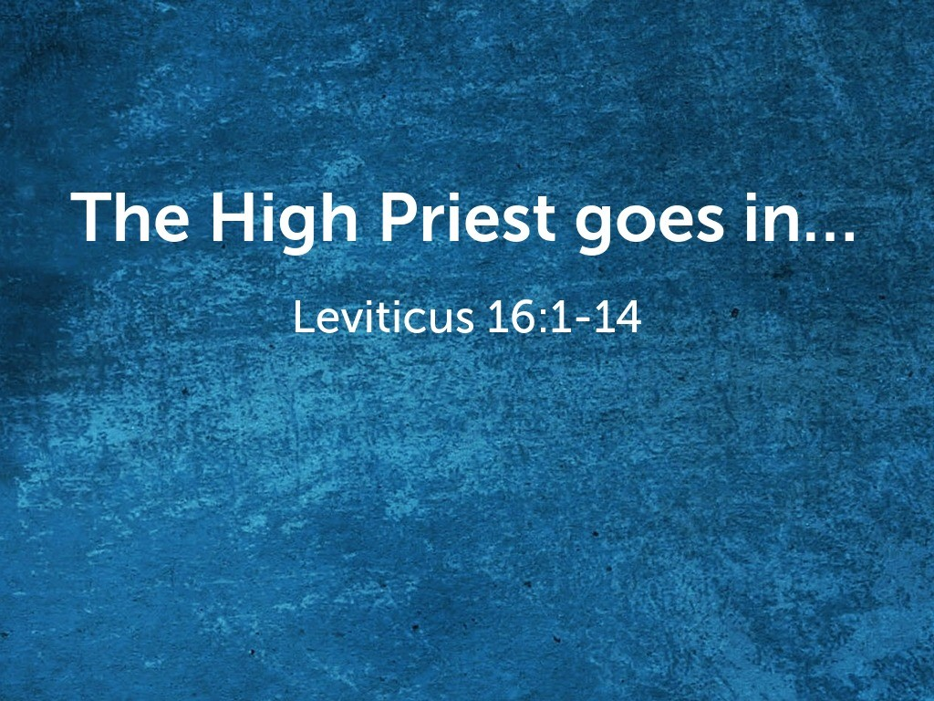

Slide 6
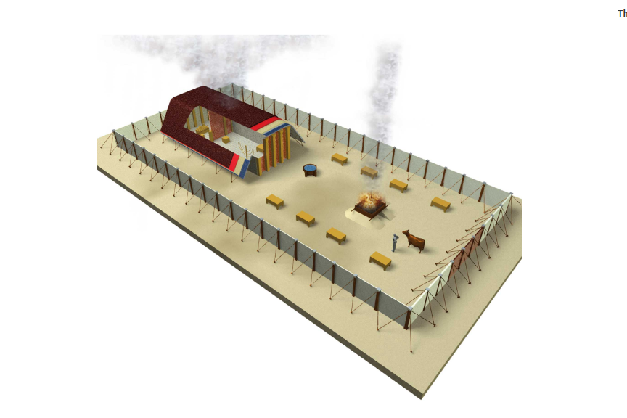
Most Holy Place
w/ Ark of the Covenant
Tent of Meeting
Altar
Courtyard

Slide 7
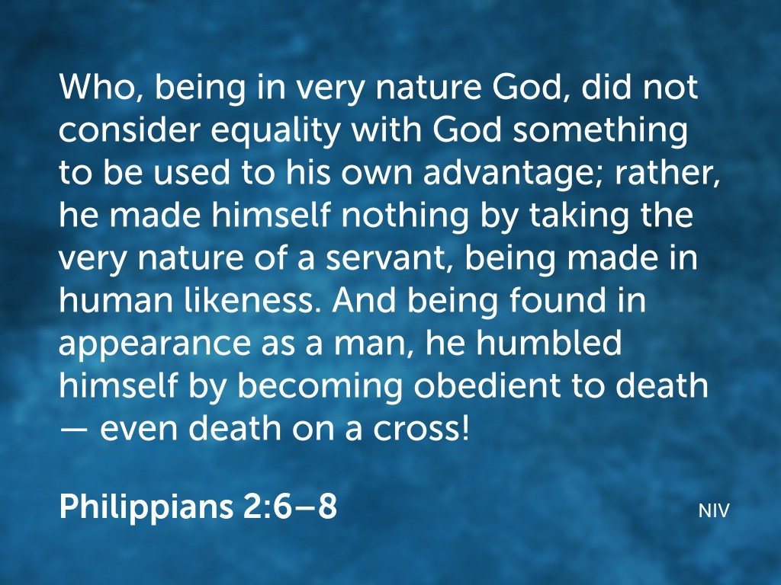

Slide 8
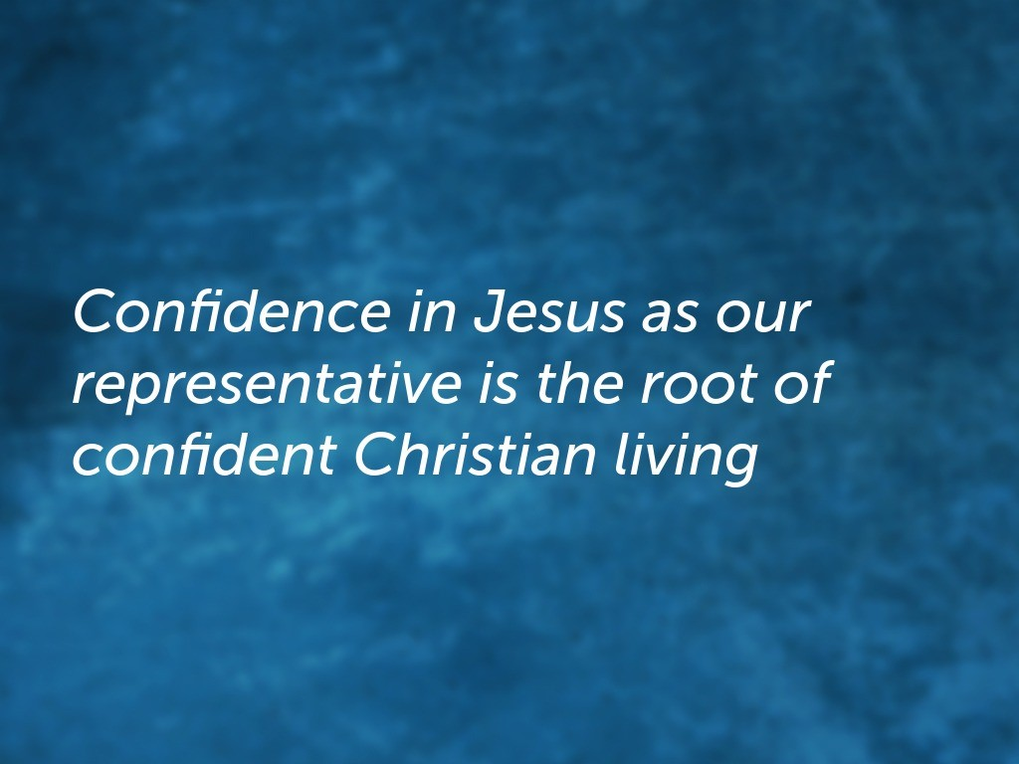

Slide 9
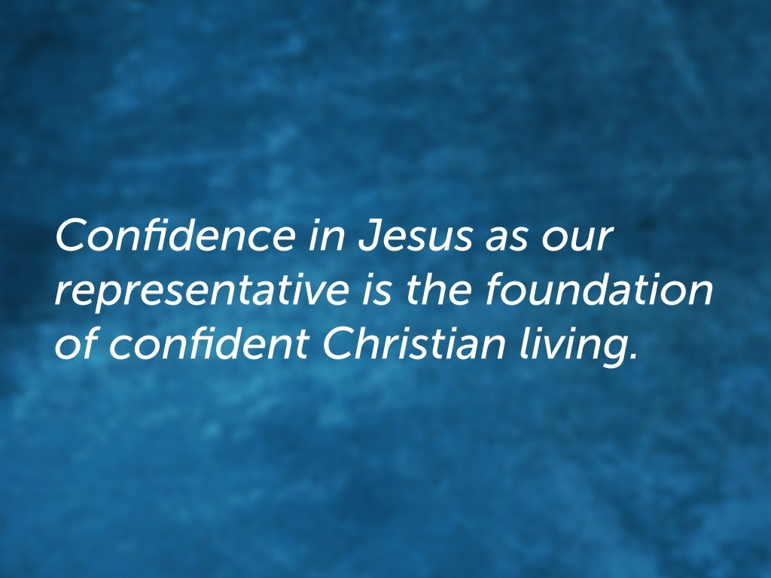

Slide 10


Slide 11
Most Holy Place
w/ Ark of the Covenant
Tent of Meeting
Altar
Courtyard

Slide 12
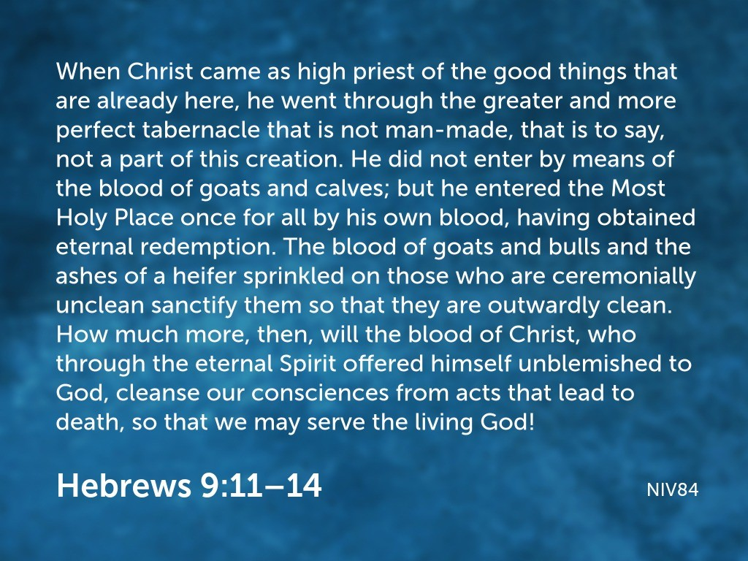

Slide 13
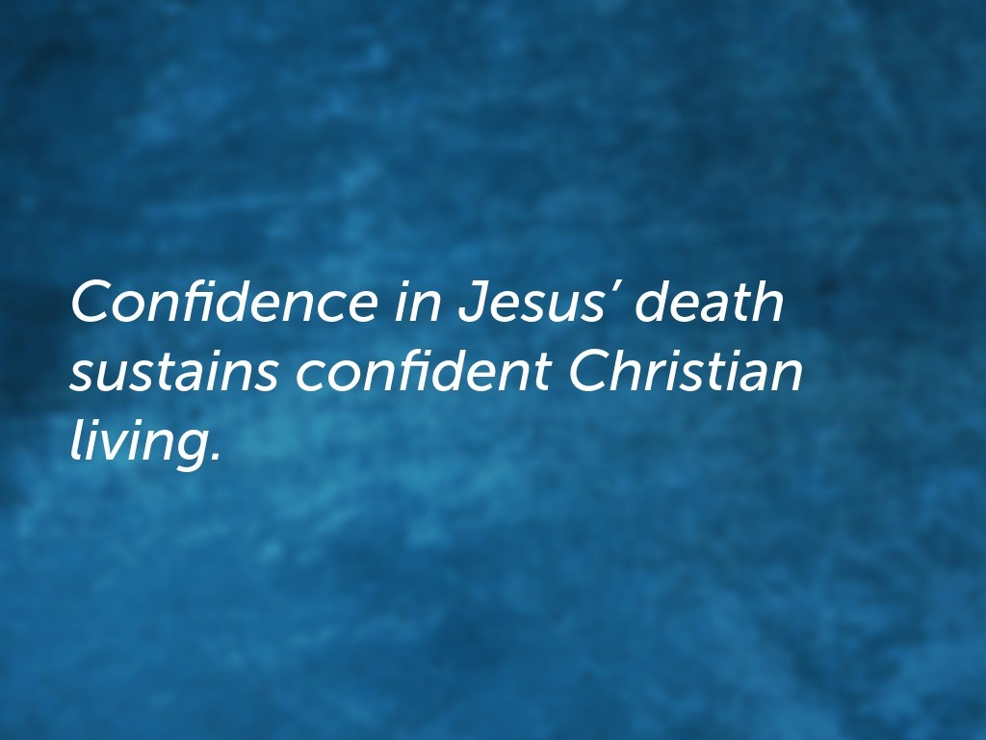

Slide 14
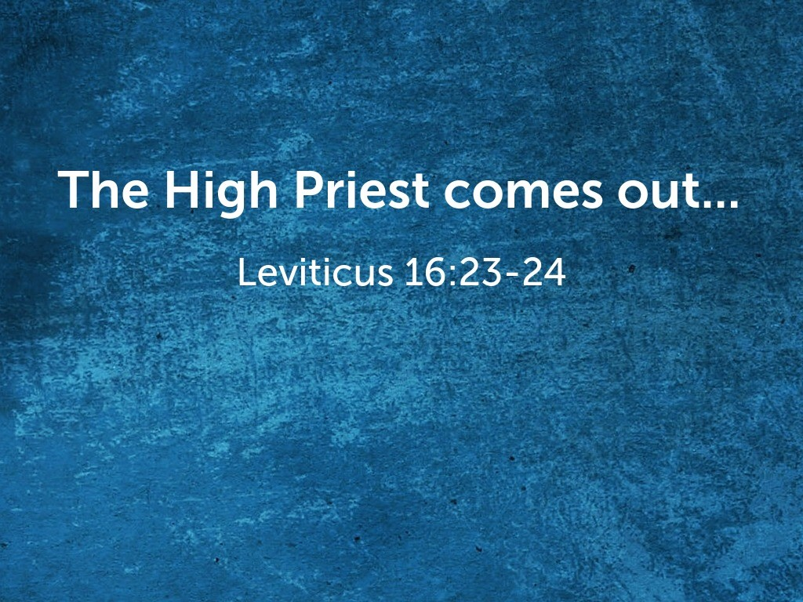

Slide 15
Most Holy Place
w/ Ark of the Covenant
Tent of Meeting
Altar
Courtyard

Slide 16
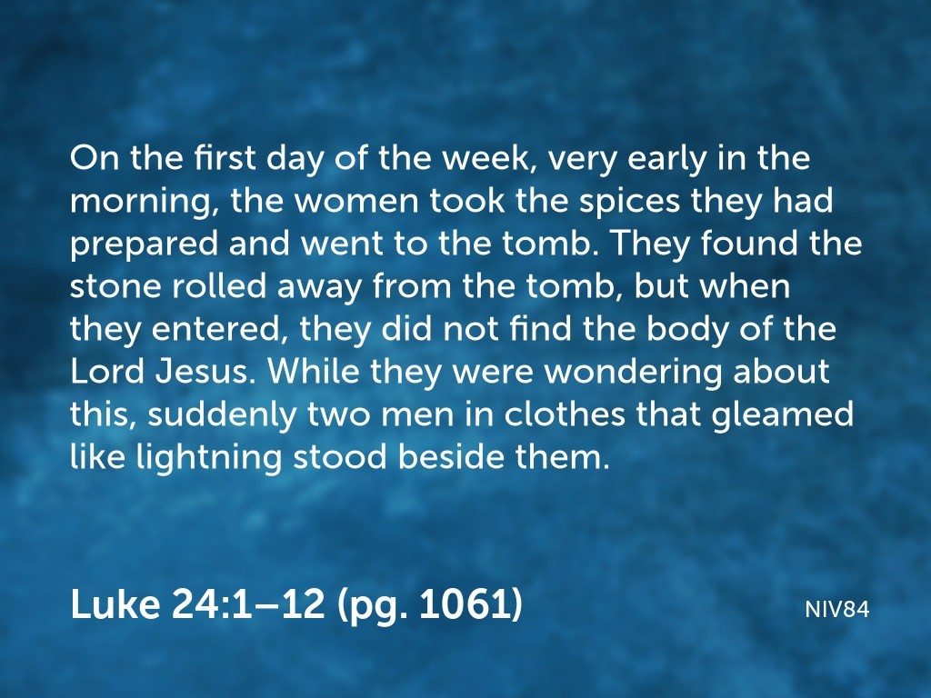

Slide 17
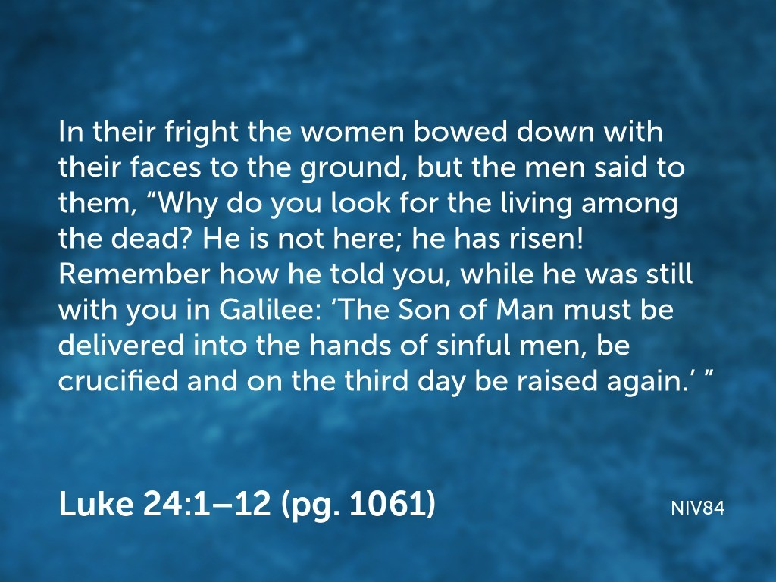

Slide 18
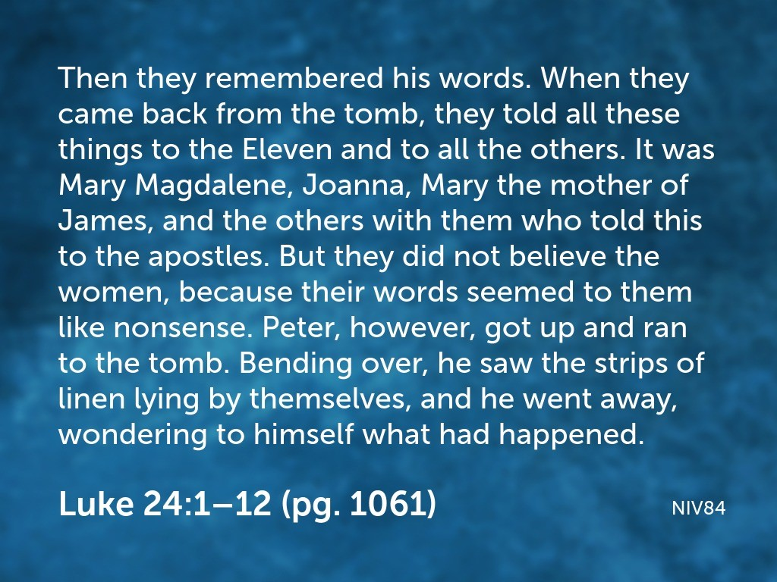

Slide 19
Most Holy Place
w/ Ark of the Covenant
Tent of Meeting
Altar
Courtyard

Slide 20
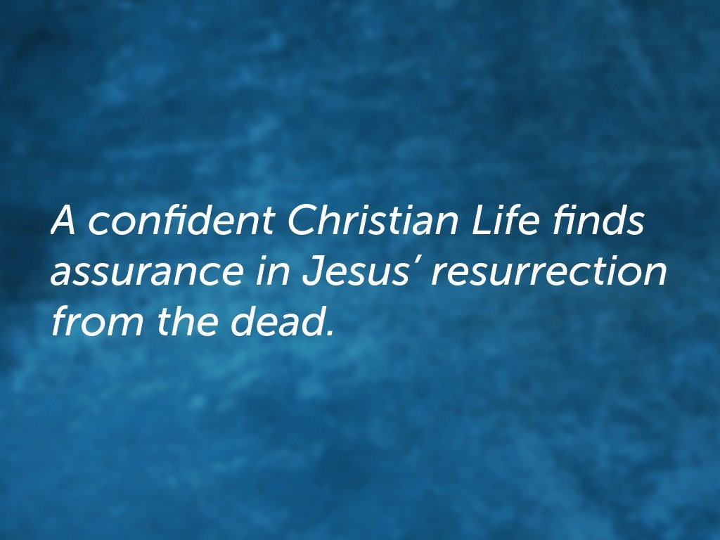

Slide 21


